Slide 1


Houssam Eddine Ariche Nov 22, 2025

Slide 2
Outline
Executive Summary
Introduction
Methodology
Results
Conclusion
Appendix

Slide 3
Executive Summary
In this capstone project, we aim to predict whether the SpaceX Falcon 9 first stage will successfully land using various machine learning classification algorithms.
The project involves several key steps:
Data collection, cleaning, and preparation
Exploratory data analysis (EDA)
Interactive data visualization
Machine learning model development and prediction
Our analyses indicate that certain features of rocket launches are correlated with the launch outcomes—success or failure. Based on the results, the Decision Tree algorithm appears to be the most effective model for predicting the successful landing of the Falcon 9 first stage.

Slide 4
Introduction
Since SpaceX is able to reuse the first stage of its Falcon 9 rocket, the launch cost is approximately Ç62 million, whereas launches from other providers can cost upwards of Ç165 million each.
So, if we can determine whether the first stage will land, we can determinethe cost of a launch. This information can be used if an alternate companywants to bid against SpaceX for a rocket launch.
Can we predict a new launch with success of the first stage landingaccording to the historical launch data?
Can we tell what is the best choice for a successful launch?

Slide 5

Section 1
5

Slide 6
Methodology
Executive Summary
Data collection methodology:
SpaceX REST API
Web Scraping (Wikipedia)
Perform data wrangling
Generate landing Class from Outcome column
Perform exploratory data analysis (EDA) using visualization and SQL
Perform interactive visual analytics using Folium and Plotly Dash
Perform predictive analysis using classification models
Using GridSearchCV to find best fit model
6

Slide 7
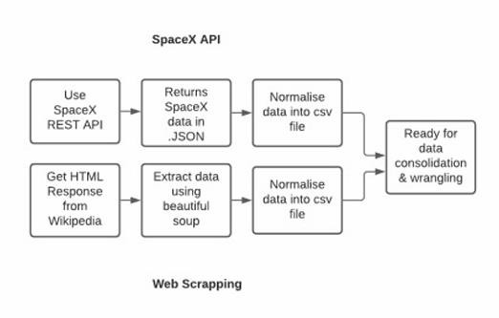
Data Collection
Data collection is the process of gathering and measuring information on targeted variables in an established system, which then enables one to answer relevant questions and evaluate outcomes. As mentioned, the dataset was collected by REST API and WebScrapping from Wikipedia
For REST API, its started by using the get request. Then, we decoded the response content as Json and turn it into a pandas dataframe using json_normalize(). We then cleaned the data, checked for missing values and fill with whatever needed.
For web scrapping, we will use the BeautifulSoup to extract the launch records as HTML table, parse the table and convert it to a pandas dataframe for further analysis

Slide 8
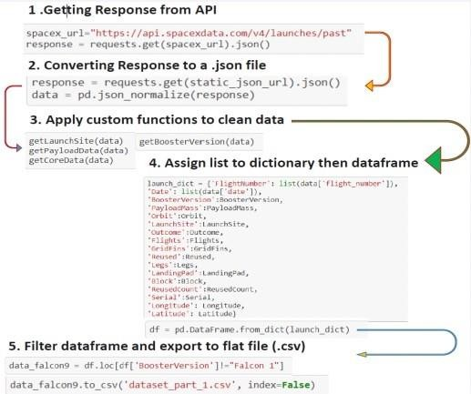
Data Collection – SpaceX API
Data collection is the process of gathering data from available sources. This data can be structured, unstructured, or semi-structured. For this project, data was collected via SpaceX API and Web scrapping Wiki pages for relevant launch data.
Get request for rocket launchdata using API
Use json_normalize method toconvert json result to dataframe
Performed data cleaning andfilling the missing value
The link to the notebook is https://github.com/HoussamEdar/Applied-Data- Science-Capstone/blob/main/1_spacex_data_collection_api.ipynb

Slide 9
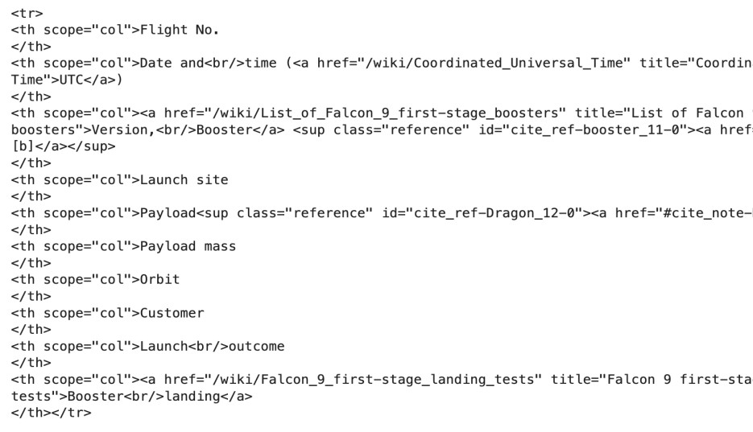
Data Collection - Scraping
Wikipedia Falcon Page
https://en.wikipedia.org/wiki/List_of_Falcon_9_ and_Falcon_Heavy_launches
import requests
from bs4 import BeautifulSoup url =
'https://en.wikipedia.org/wiki/List_of_Falcon
_9_and_Falcon_Heavy_launches' response = requests.get(url)
html_data = response.text
soup = BeautifulSoup(html_data)
Wikipedia Page
My Notebook
https://github.com/HoussamEdar/Applied-Data- Science- Capstone/blob/main/2_webscraping_spacex_launches
_from_wikipedia.ipynb
HTML
DataFrame

Slide 10
Data Wrangling
My Notebook
https://github.com/HoussamEdar/Applied-Data- Science- Capstone/blob/main/3_spacex_data_wrangling.i pynb
Transform raw data to useful data. For example, convert original outcome labels into landing class that represent landing classification which will be our new landing prediction target.
1 for success
0 for failure
Original Outcome
Landing Class
True ASDS
None
None
1 |  | 0
1 |  | 0
1 |  | 0
0 |  | 0
True RTLS
False ASDS
True Ocean
False Ocean
None
ASDS
False
RTLS

Slide 11

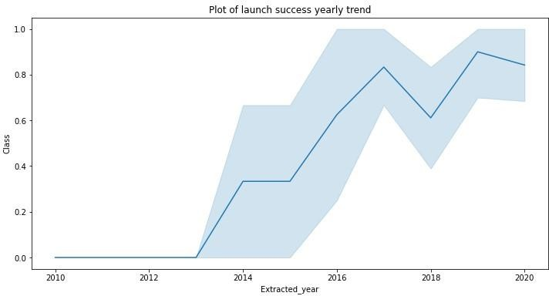
EDA with Data Visualization
1
1
We explored the data by visualizing the relationship between flight number and launch Site, payload and launch site, success rate of each orbit type, flight number and orbit type, the launch success yearly trend.
The link to the notebook is https://github.com/HoussamEdar/Ap plied-Data-Science- Capstone/blob/main/4_eda_data_vis ualization.ipynb

Slide 12
EDA with SQL
We loaded the SpaceX dataset into a PostgreSQL database without leaving thejupyter notebook.
We applied EDA with SQL to get insight
from the data. We wrote queries tofind out for instance:
The names of unique launch sites in the space mission.
The total payload mass carried by boosters launched by NASA (CRS)
The average payload mass carried by booster version F9 v1.1
The total number of successful and failure mission outcomes
The failed landing outcomes in drone ship, their booster version and launch site names.
The link to the notebook is https://github.com/HoussamEdar/Applied-Data-Science-
Capstone/blob/main/5_eda_using_sql.ipynb
12

Slide 13
Build an Interactive Map with Folium
We marked all launch sites, and added map objects such asmarkers, circles, lines to mar k the success or failure oflaunches for each site on the folium map.
We assigned the feature launch outcomes (failure orsuccess) to class 0 and 1.i.e., 0 for failure,and 1 for success.
Using the color-labeled marker clusters, we identified which
launch sites have relatively high success rate.
We calculated the distances between a launch site to itsproximities. We answered so me question for instance:
Are launch sites near railways, highways and coastlines.
Do launch sites keep certain distance away from cities.
The link to the notebook is https://github.com/HoussamEdar/Applied-Data-Science- Capstone/blob/main/6_launch_site_location_visualization_with_folium.ipynb

Slide 14
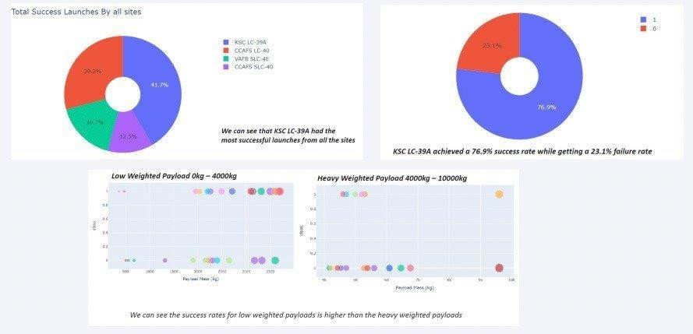
Build a Dashboard with Plotly Dash
We built an interactive dashboardwith Plotly dash
We plotted pie charts showing thetotal launches by a certain sites
We plotted scatter graph showingthe relationship with Outcome andPayloa
d Mass (Kg) for the differentbooster version.
The link to the notebook https://github.com/HoussamEdar/Applied-Data- Science-Capstone/blob/main/7_spacex_data_intereactive_dashboard_app.py

Slide 15
Predictive Analysis (Classification)
We loaded the data using numpy and pandas, transformed the data, split our datainto trai
ning and testing.
We built different machine learning models and tune different hyperparametersusing
GridSearchCV.
We used accuracy as the metric for our model, improved the model using featureengine ering and algorithm tuning.
We found the best performing classification model.
The link to the notebook is https://github.com/HoussamEdar/Applied-Data- Science-Capstone/blob/main/8_spacex_machine_learning_prediction.ipynb

Slide 16
Results
The larger the flight amount at a launch site, the greater the success rate ata la unch site
Low weighted payloads perform better than the heavier payloads.
Launch success rate started to increase in 2013 till 2020.
KSC LC 39A had the most successful launches from all the sites.
Orbits ES-L1, GEO, HEO, SSO, VLEO had the most success rate.
The Decision tree classifier is the best machine learning algorithm for thistas
k.

Slide 17

Section 2

Slide 18
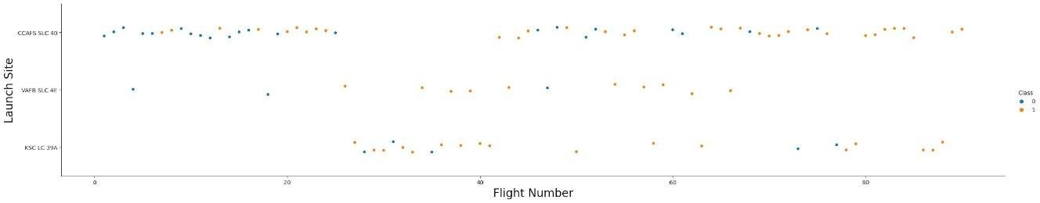
Flight Number vs. Launch Site
From the figure below, it can be noted that the launch site CCAFS SLC 40 has launched the highest number of rockets compared to the other sites.
Also, it is shown that the later flights from launch sites VAFB SLC 4E and KSC LC 39A showed a higher success rate compared to the earlier flights.

Slide 19
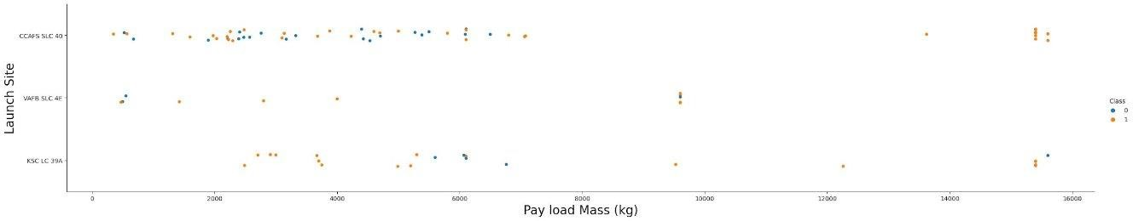
Payload vs. Launch Site
From the figure below, it is observed that VAFB-SLC 4E launch site has no rockets launched for heavy payload mass greater than 10000kg.
It is also observed that most of the rockets launched in all launch sites have a payload mass of less than 9000kg.
Compared to VAFB-SLC 4E and KSC LC 39A, CCAFS SLC 40 has a higher success rate for rockets launched with a heavy payload mass of 14000kg and 16000kg.

Slide 20
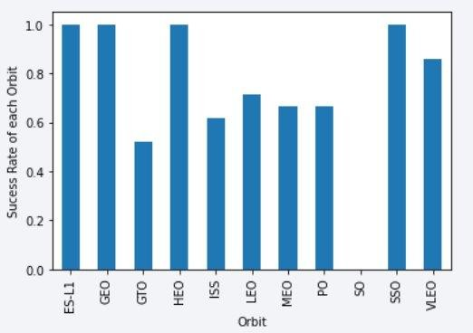
Success Rate vs. Orbit Type
The bar chart shows the success rate for each orbit. It can be seen that four orbits — ESL1, GEO, HEO, and SSO — achieved a perfect success rate of 1, while SO had a success rate of 0. The remaining orbits had success rates ranging between 0.5 and 0.8.

Slide 21
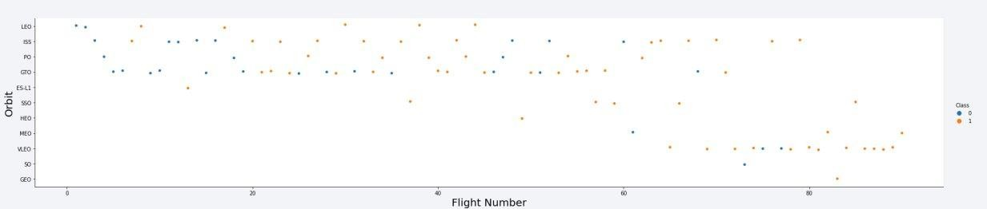
Flight Number vs. Orbit Type
From the scatter plot, it can be observed that as the number of flightsincreas es the success rate also increases. Hence, we can say thatthe past launches h elped in improving the success rate

Slide 22
Payload vs. Orbit Type
It can be seen that for some orbit, a heavier pay load mass helps t oimprove the success rate, for example the LEO orbit. However, f or someorbit such as GTO, increasing the pay load mass does not seem toimprove the success rate.
•

Slide 23
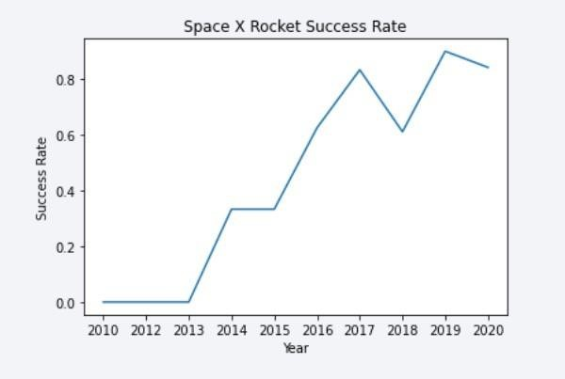
Launch Success Yearly Trend
Launch success rate has increased significantly since 2013 and has stabilized since 2019, potentially due to advance in technology and lessons learned

Slide 24
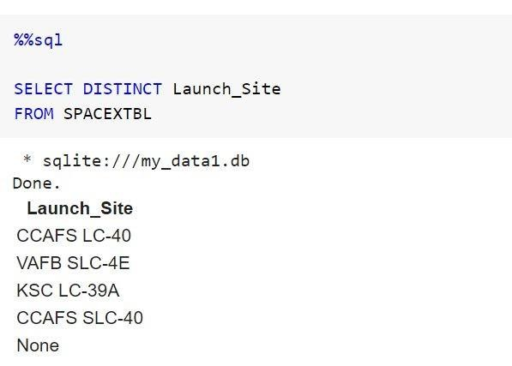
All Launch Site Names
An SQL table called SPACEXTBL using the existing data frame.
To find the Unique Launch Sites, the keyword DISTINCT was used on the column.

Slide 25
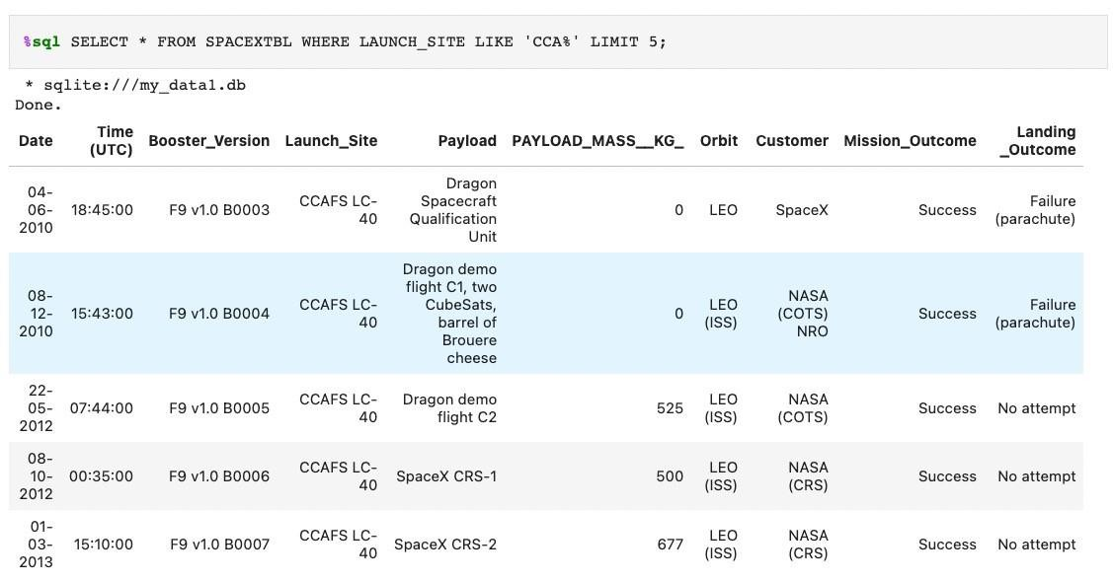
Launch Site Names Begin with 'CCA'
We used the query bellow to display 5 records where launch sites begin with `CCA`

Slide 26
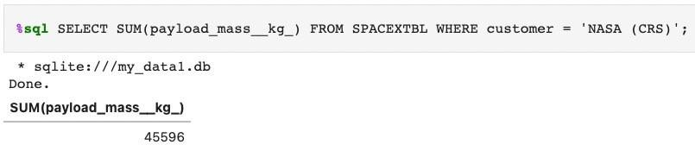
Total Payload Mass
We calculated the total payload carried by boosters from NASA as 45596 using the query below

Slide 27
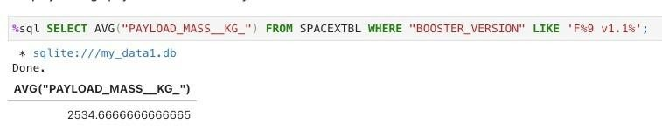
Average Payload Mass by F9 v1.1
We calculated the average payload mass carried by booster
version F9 v1.1 as 2534.66

Slide 28
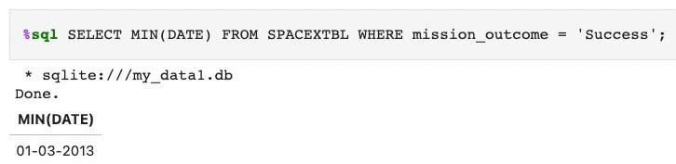
First Successful Ground Landing Date
We observed that the dates of the first successful landing outcome on
ground pad was January 3rd, 2013.

Slide 29
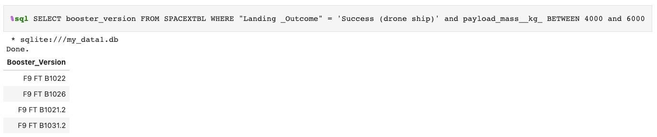
Successful Drone Ship Landing with Payload between 4000 and 6000
We used the WHERE clause to filter for boosters which have successfully landed on drone ship and applied the AND condition to determine successful landing with payload mass greater than 4000 but less than 6000.

Slide 30
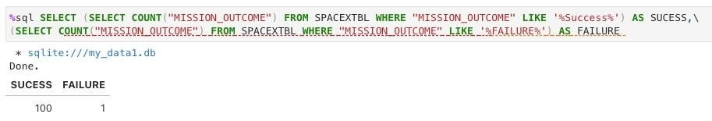
Total Number of Successful and Failure Mission Outcomes
We used wildcard like ‘%’ to filter for WHERE Mission Outcome
was a success or a failure.

Slide 31
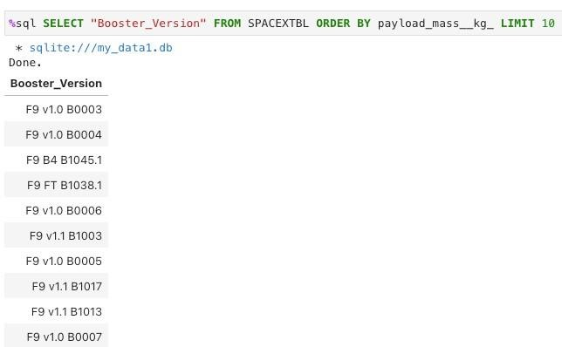
Boosters Carried Maximum Payload
These are the names of the booster which have carried the maximum
payload mass

Slide 32

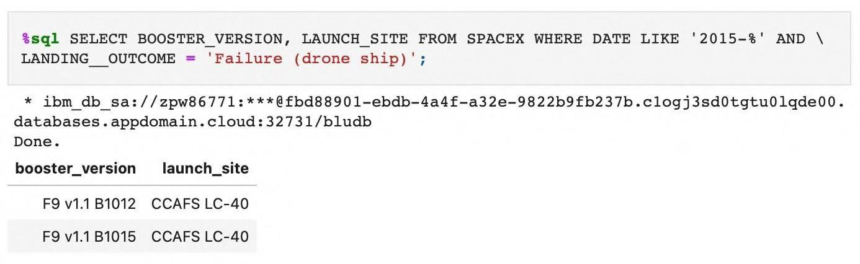
2015 Launch Records
We used a combinations of the WHERE clause, LIKE, AND, and BETWEEN conditions to filter for failed landing outcomes in drone ship, their booster versions, and launch site names for year 2015

Slide 33
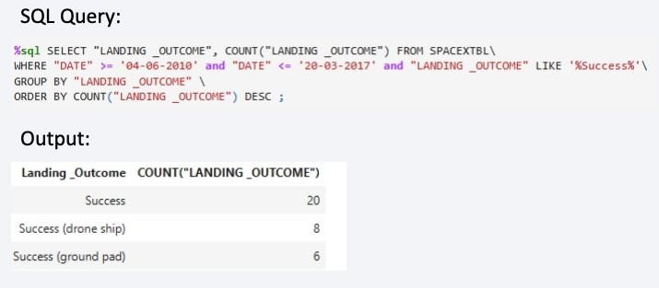
Rank Landing Outcomes Between 2010-06-04 and 2017-03-20
We selected Landing outcomes and the COUNT of landing outcomes from the data and used the WHERE clause to filter for landing outcomes BETWEEN 04-06-2010 to 20-03-2017
We applied the GROUP BY clause to group the landing outcomes and the ORDER BY clause to order the grouped landing outcome in descending order.

Slide 34

Section 3

Slide 35

All launch sites global map markers

Slide 36
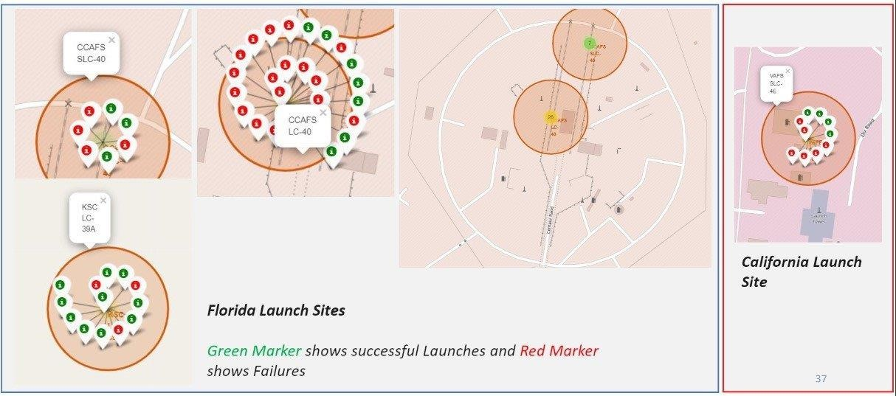
Launch Outcomes for Space X Falcon 9

Slide 37

Launch Site distance to landmarks
Replace <Folium map screenshot 3> title with an appropriate title
Explore the generated folium map and show the screenshot of a selected launch site to its proximities such as railway, highway, coastline, with distance calculated and displayed
Explain the important elements and findings on the screenshot

Slide 38

Section 4

Slide 39
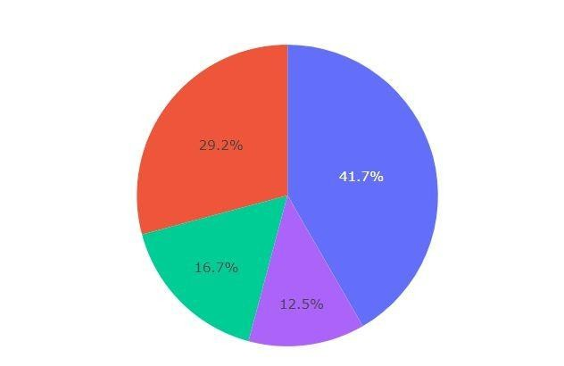
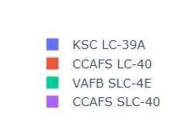
Pie Chart of Launch Success for all Sites
it is shown has the
that KSC LC-39A largest success
rate with about 41.7% of
the total success ratio
with other sites.

Slide 40
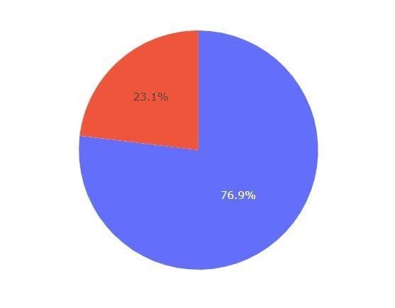
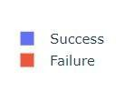
Pie chart of Launch site with highest success ratio
It is also evident from Figure 25 that KSC LC-39A has the highest success ratio with about 76.9%, compared to the other sites;
73.1% for CCAFS LC-40
60% for VAFB SLC-4E
57.1% for CCAFS SLC-40

Slide 41
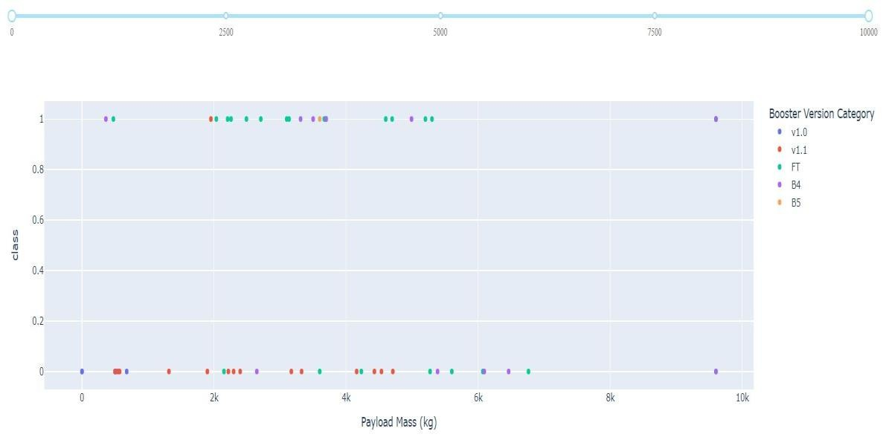
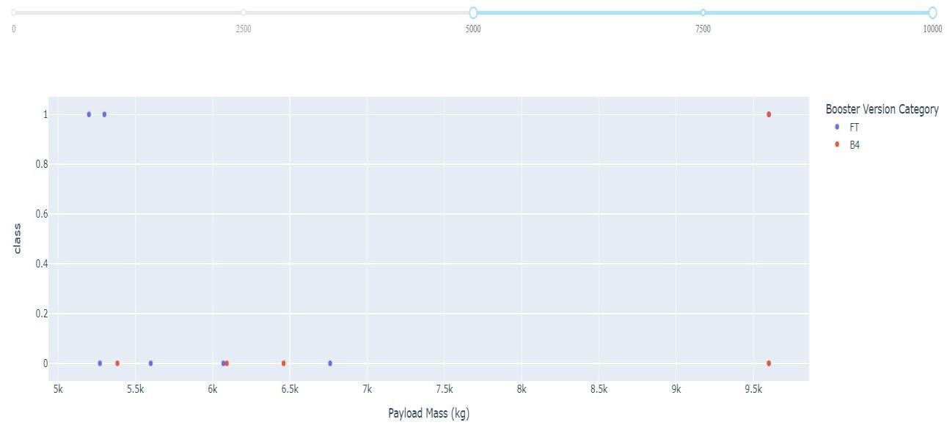
Payload vs Launch outcome for all sites
From the figures below, Booster version FT has the highest success rate with its payload mass of about between 700kg to 5,500kg.
It is also shown that rockets with payload mass above 5,500kg have a lower success rate, which means the heavier the payload, the slimmer the chance of a successful outcome.

Slide 42

Section 5

Slide 43
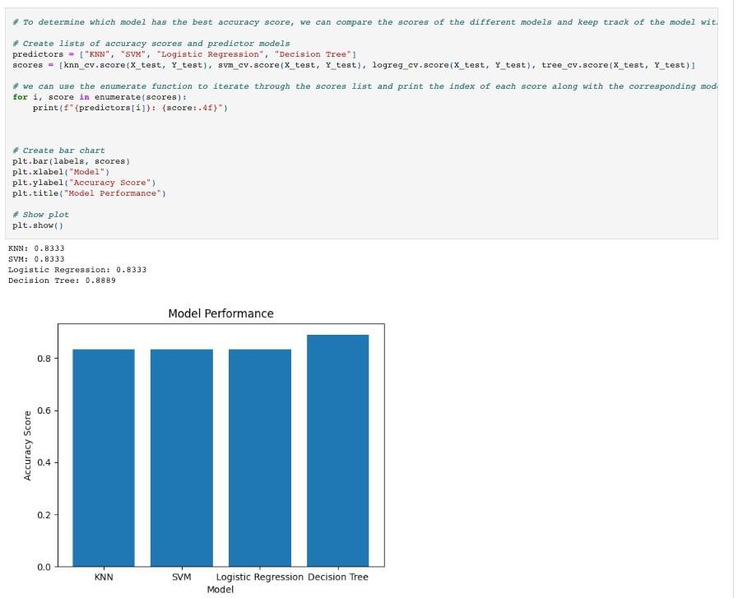
Classification Accuracy
The decision tree classifier is the model with the highest classification accuracy with a 88.8%
43

Slide 44
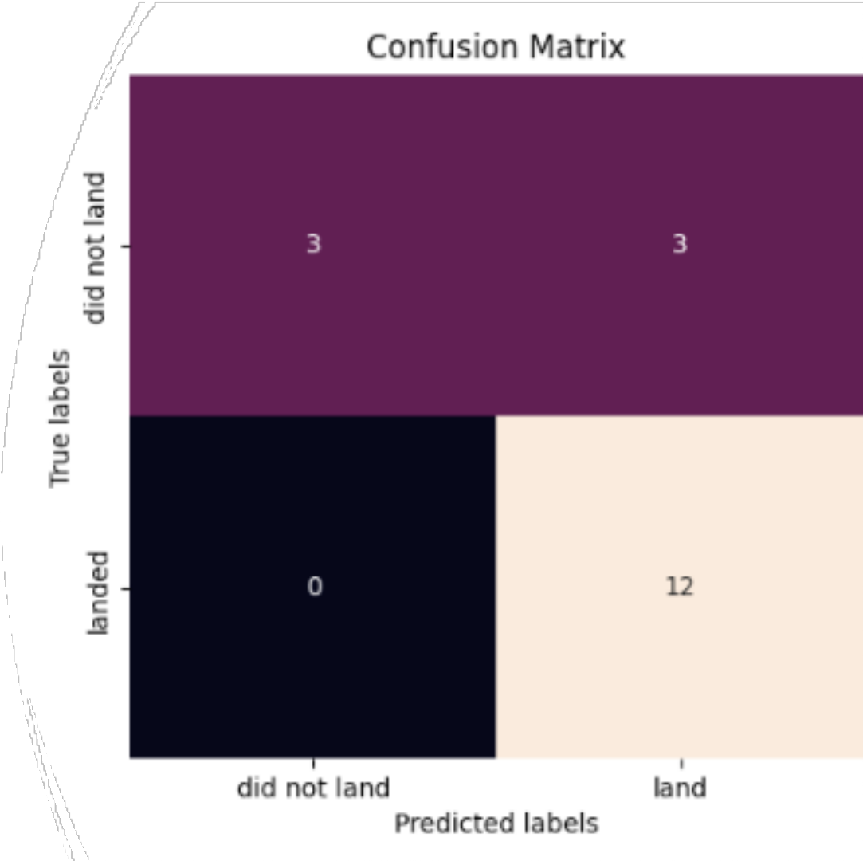
Confusion Matrix
The confusion matrix for the decision tree classifier shows that the classifier can distinguish between the different classes. The major problem is the false positives .i.e., unsuccessful landing marked as successful landing by the classifier.

Slide 45
Conclusions
For a successful mission, the mass of the payload should be considered as rockets with smaller payload had a higher success rate.
Orbit type should also be considered because rockets launched to certain orbits (VLEO, ES-L1, GEO, HEO, and SSO) had higher success rates compared to others.
Launch sites are located in coastal cities for easy retrieval/recovery and far from busy areas like major highways and cities to minimize casualties in the event of a failure.
In recent years the outcome has been more successful as later flight launches had a higher success rate.

Slide 46
Appendix
https://github.com/HoussamEdar/Applied-Data-Science-Capstone/tree/main

Slide 47


